Slide 1
STUDENT PERFORMANCE PREDICTIONS An analysis of anonymized student academic performance data & a machine-learning model to predict future performance
By
Kameron Thao,
Nou Yang,
Mary Vang,
&
William Thomer
For the edX / Tulsa Community College “Cyber Skills Center” Data Analytics Bootcamp, Inaugural Cohort, 2022-2023
(Dataset comes courtesy of Royce Kimmons, http://roycekimmons.com)

Slide 2
Abstract
Analysis of various factors that can impact a high school student's academic performance. The objective of this analysis is to measure any correlation between a student's circumstances, demographics, & their overall performance on examinations in the subjects of Math, Reading, & Writing.
Further, a machine learning model which has been trained to predict a student’s potential performance in any of these fields based upon the given dataset.

Slide 3
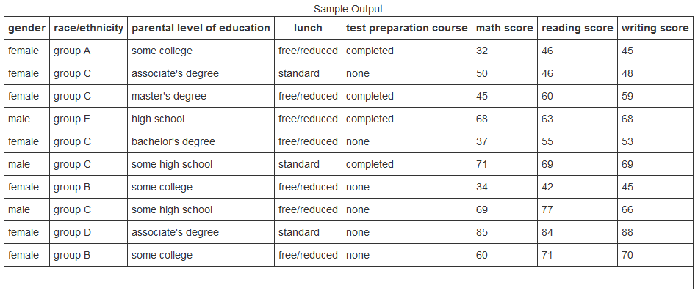
Data Set Courtesy of Royce Kimmons, http://roycekimmons.com © 2012, Royce Kimmons
Data set is a generated sample of 1,000 students who are listed & compared according to the following:
Individual examination scores in the subjects of Math, Reading, and Writing.
Circumstantial information; their parental education level & if their lunch is standard-cost or provided for free or at a discount.
Demographic information; sex & race/ethnicity.

Slide 4
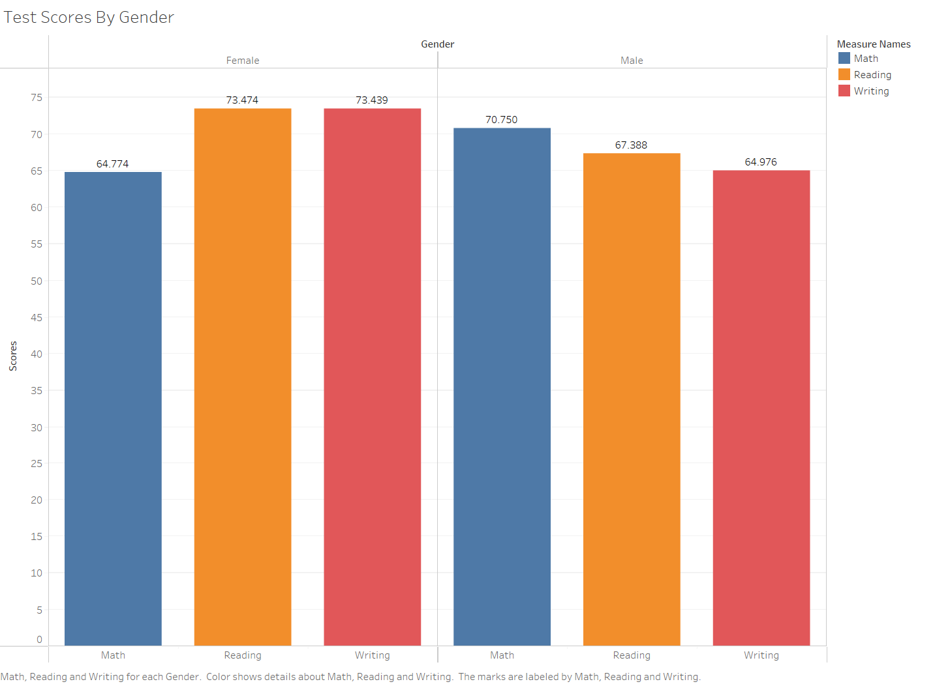
Analysis of Performance by Sex
Female students have higher examination scores in the subjects of Reading & Writing, on average. Conversely, Male students have higher average scores in Math.

Slide 5
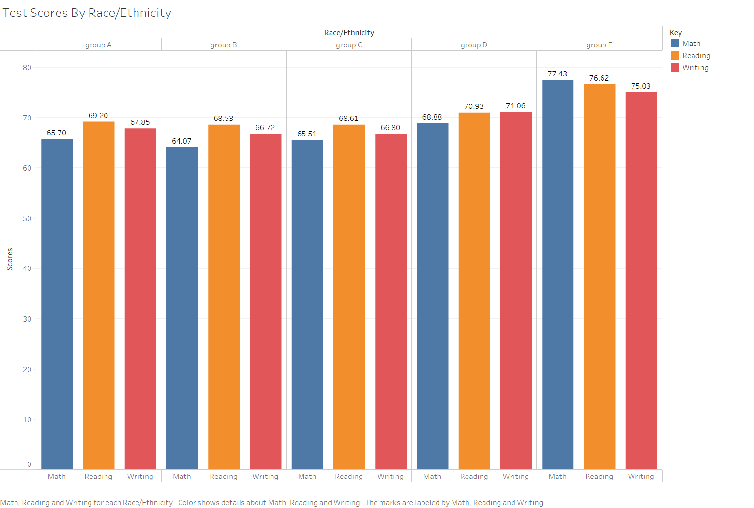
Analysis of Performance by Race & Ethnicity
Students belonging to racial/ethnic ‘Group E’ consistently score higher on-average in all subject areas. Average Math scores were at the bottom of each racial/ethnic group’s performance, with the sole exception of ‘Group E’, who scored the highest overall.

Slide 6
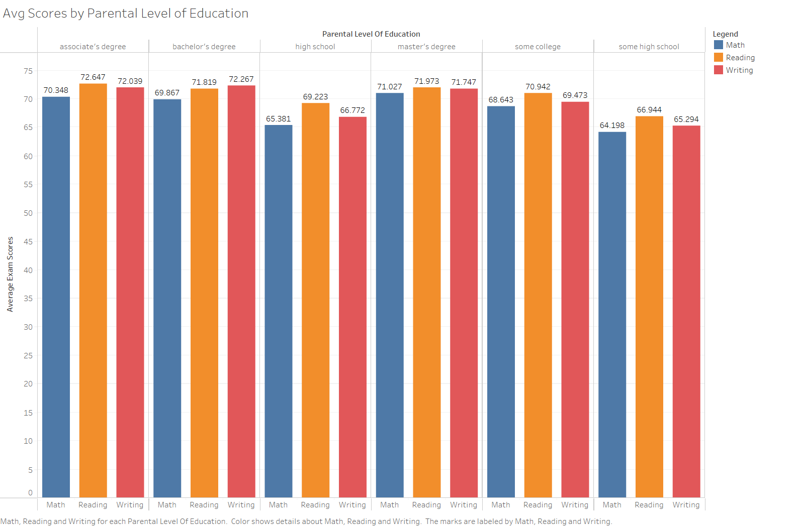
Analysis of Performance by Parental Level of Education
Students with parents who have not completed high-school consistently have the lowest average test scores across all subjects. Any level of college education significantly increases average scores, though there seems to be a trend of diminishing returns. (i.e., Master’s vs. Associate’s.)

Slide 7
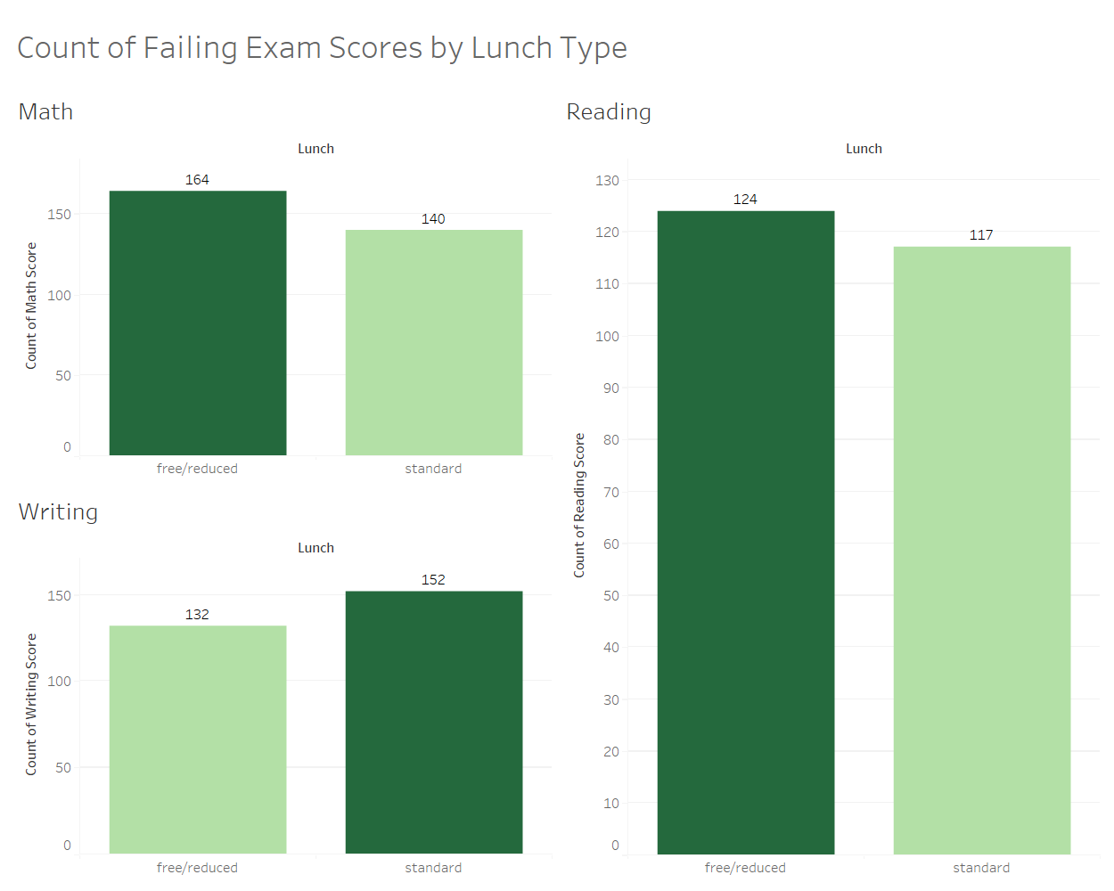
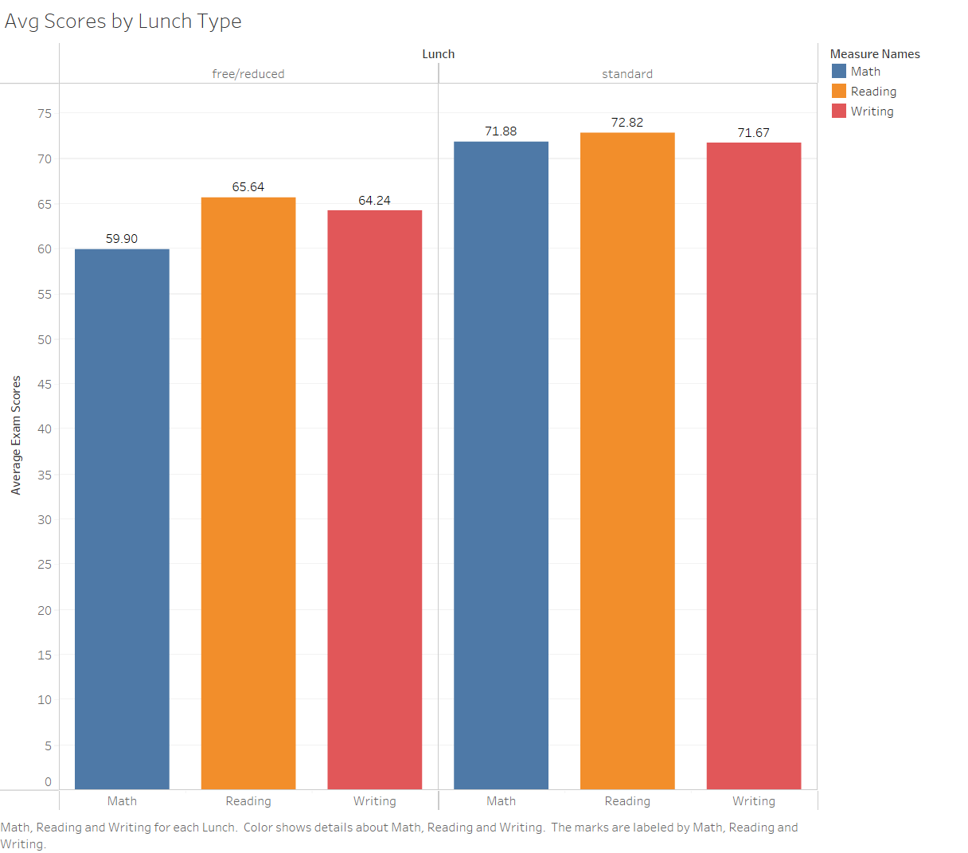
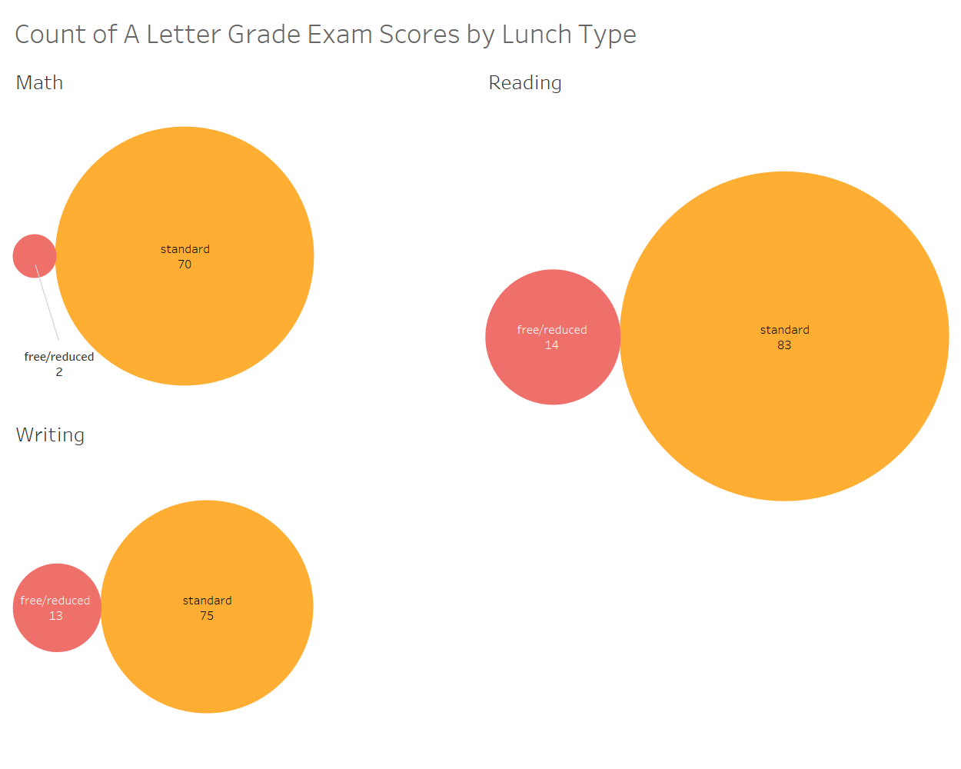
Analysis of Performance by Lunch Type
Students who pay standard lunch-fees score, on average, significantly higher in all subject areas. Further, students who pay standard lunch-fees score ‘A’ letter-grades in all subject areas at overwhelmingly higher rates than those who receive their lunches at no/reduced cost.
No significant effect on failure rates is observed. Therefore, payment of standard lunch fees correlate strongly with higher average performance, but do not correlate with test failure.

Slide 8
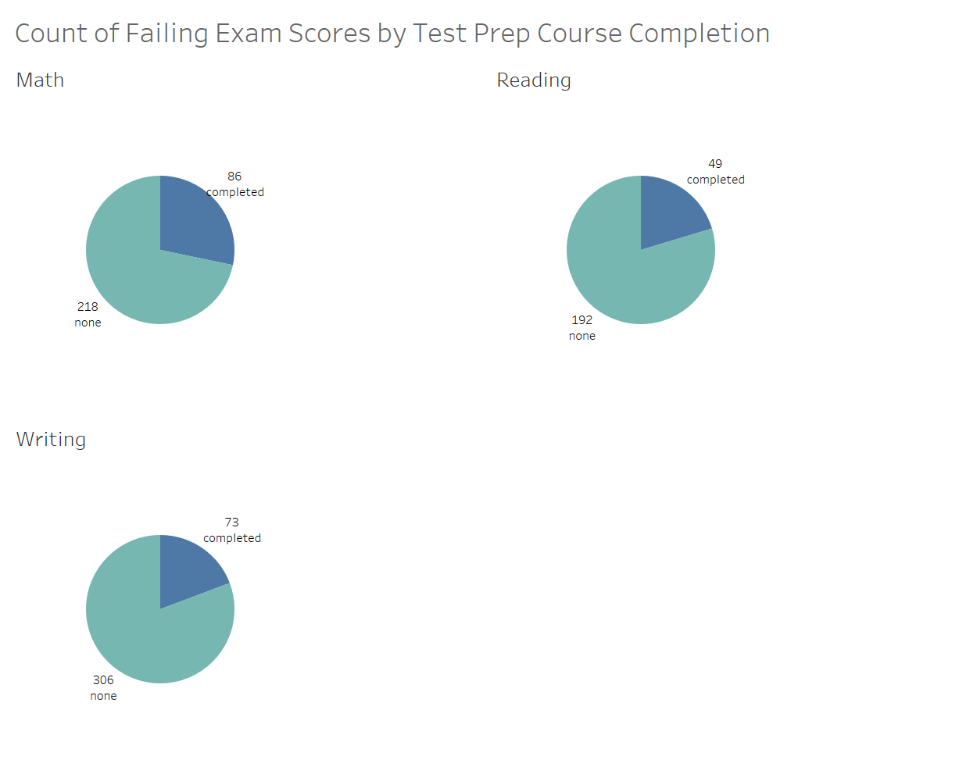
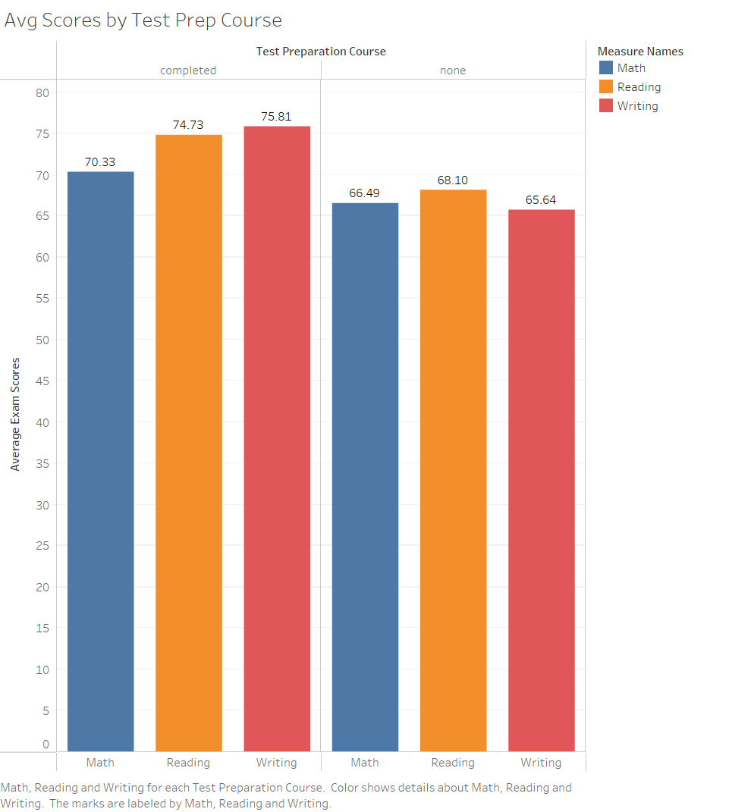
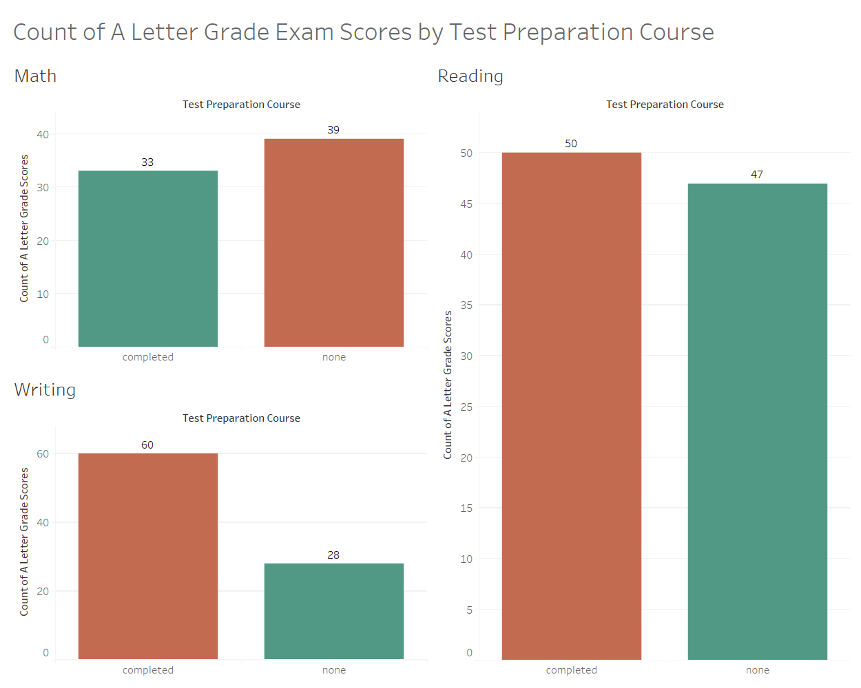
Analysis of Performance by Test Preparation Course Completion
Students who have completed a test-preparation course consistently have the fewest failing exam scores & more ‘A’ letter grade exam scores in all 3 subject areas.

Slide 9
Summary of Findings
The most successful demographic of students across all fields (& by a wide margin) are Females of Race ‘E’ whose parents have completed any college degree, who also pay standard lunch fees, and have completed a test preparation course.
Conversely, the lowest-performing demographic are Males of Race ‘B’ whose parents have not finished high-school, receive their lunch for free or at a reduced price, & have not completed any test preparation courses.
Male students tend to have higher math scores than Female students on average. Likewise Female students tend to earn higher average scores than their Male counterparts in Reading and Writing exams.
Students in Racial/Ethnic Group ‘E’ generally have higher scores across all subject areas by a wide margin. Groups ‘B’ and ‘C’ are statistically similar regarding their outcomes, being that they rank among the bottom across all subject areas.
Payment of standard lunch fees correlate strongly with higher average performance, but do not correlate with test failure rates.

Slide 10
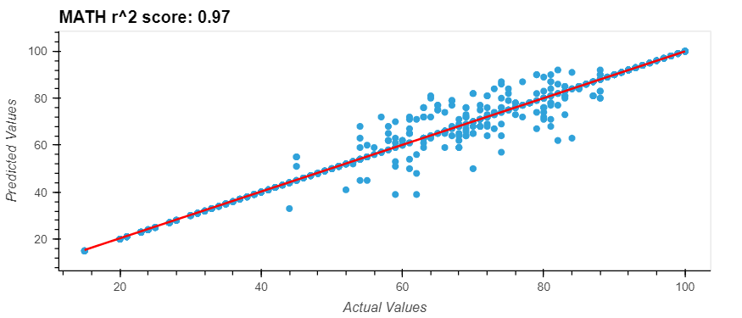
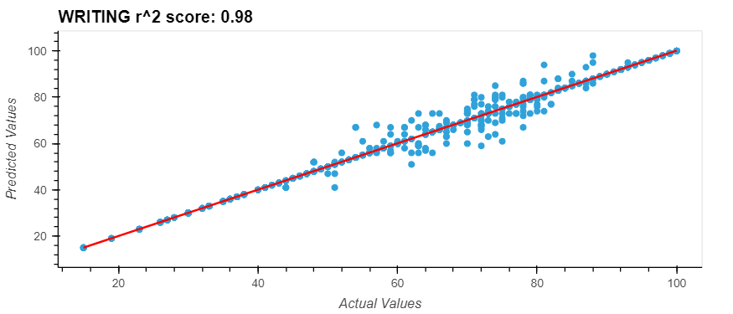
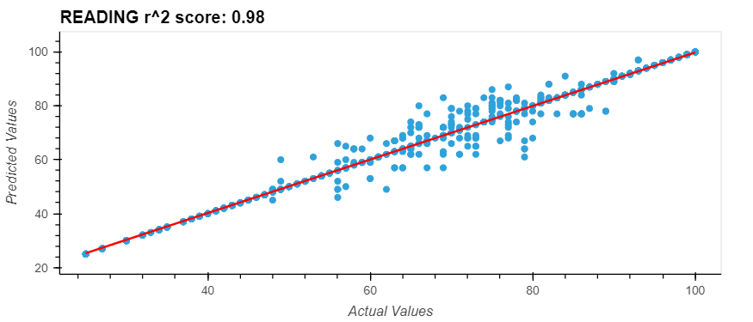
Machine Learning Models

Slide 11
The data set is first ‘cleaned’ by converting any categorical objects to a numerical format.
Imbalanced-learn’s RandomOverSampler is used to then balance the data set.
After splitting the data set into separate ‘Testing’ & ‘Training’ sets, the machine-learning model is then run through the “test-&-train” process.
Scikit-learn’s DecisionTreeRegressor is used to predict exam scores.
Scikit-learn’s Regression Metrics are used to measure the performance of the model.
Model
Workflow

Slide 12
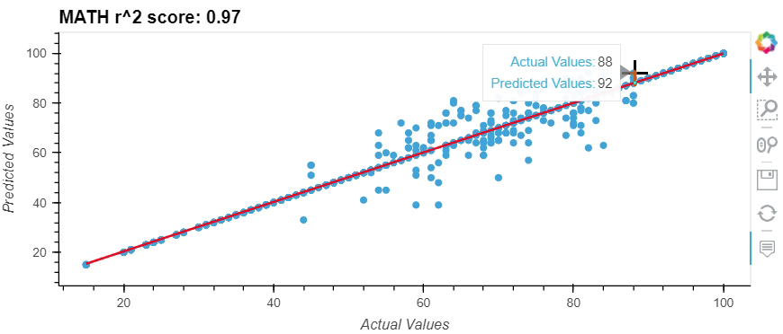
Math Score Model
Score of 0.97
R-squared score of 0.97
Mean Squared Error of 17.36
Root Mean Squared Error of 4.17
Standard Deviation of 23.38

Slide 13
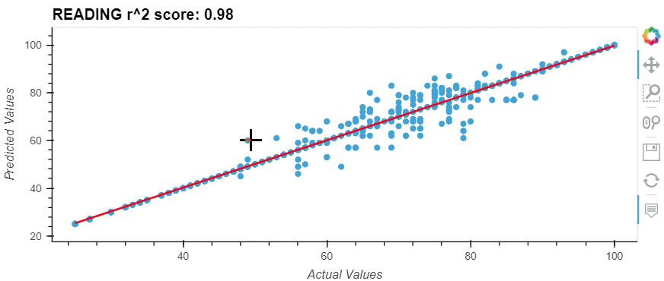
Reading Score Model
Score of 0.98
R-squared score of 0.98
Mean Squared Error of 11.04
Root Mean Squared Error of 3.32
Standard Deviation of 21.17

Slide 14
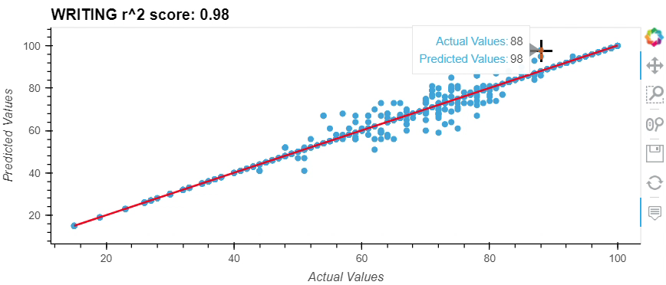
Writing Score Model
Score of 0.98
R-squared score of 0.98
Mean Squared Error of 7.98
Root Mean Squared Error of 2.82
Standard Deviation of 21.98

Slide 15
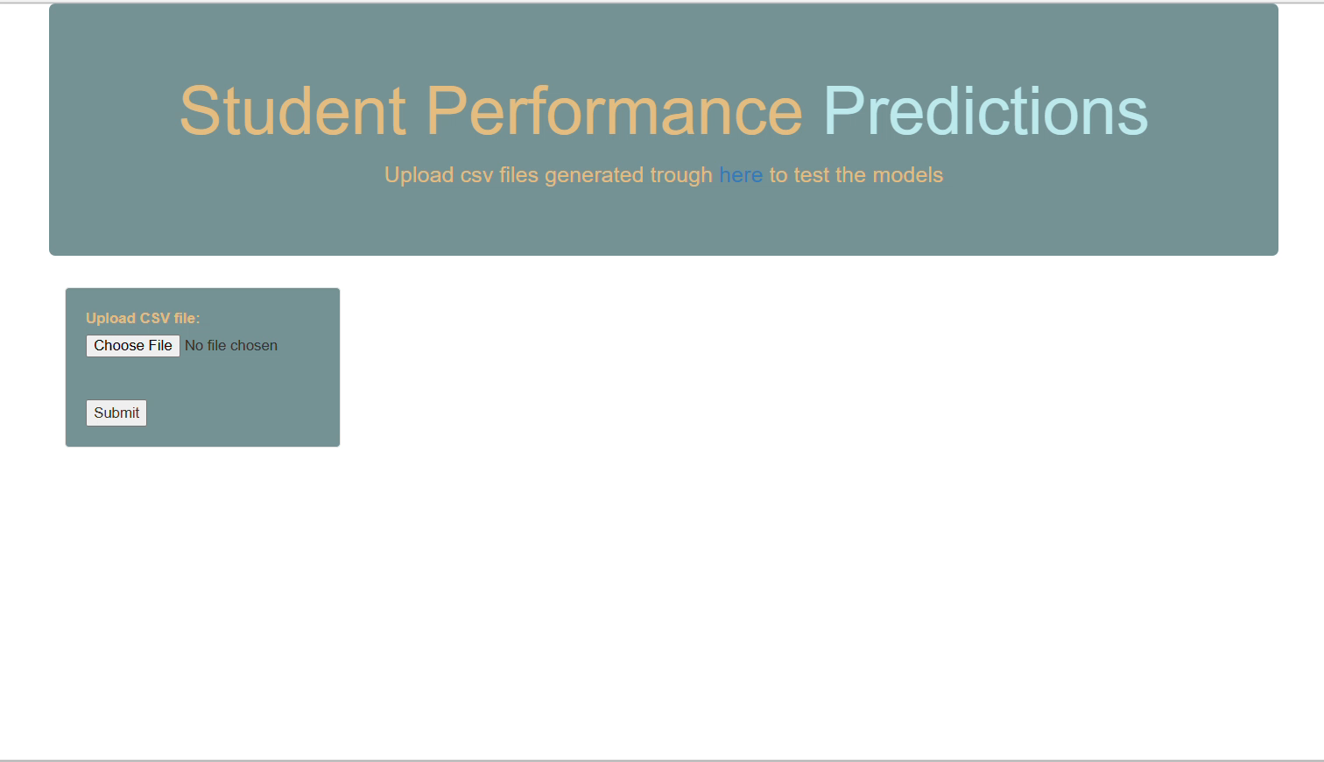
Summary of Machine Learning Models
Overall, the ability of these models to predict student exam performance across all three subject areas is strongly supported by the features. Further development of these models might include other algorithms which could serve to improve their interpretability and accuracy, such as:
Random Forest Regressor
Support Vector Regressor

